Slide 1
Kickstarting Kickstarter
[Machine Learning Group Project Feb 2021]

Slide 2
“ Which Kickstarter Projects
will be Successful ? “
Predict ^{via} Machine Learning

Slide 3
Kickstarter Framework
Kickstarter Success is defined by “Funding Goal has been Reached within Time Limit”
01
02
03
EDA
Kaggle Dataset 2018
[ 378661, 15 ]
Data Extraction & Exploration
Preprocessing
Machine
Learning
Create Model
Evaluate Model
Business
Value
Testing Model
Success Rate

Slide 4
01/03
EDA -- Exploratory Data Analysis
The untold story behind
Kickstarter stats

Slide 5
[ Kickstarter Overview ]
25%
8 Mths
30%
75%
Only 25% of projects delivered on time
When You Fail,
You Fail Big
After 8 months 75% of all projects are delivered
38 %
Success
18 %
Success
7 %
Success
$10K
$50K
$100K
9 out of 10 failed projects did not reach 30% of their funding goals
The larger the project, the more likely that it will fail
Notes:
-- Sell within 2-3pm
-- The larger the project, the more likely it will be delayed, and the longer it will be delayed

Slide 6
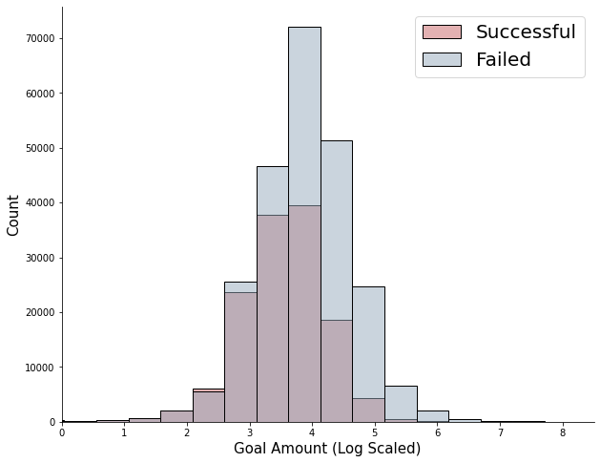
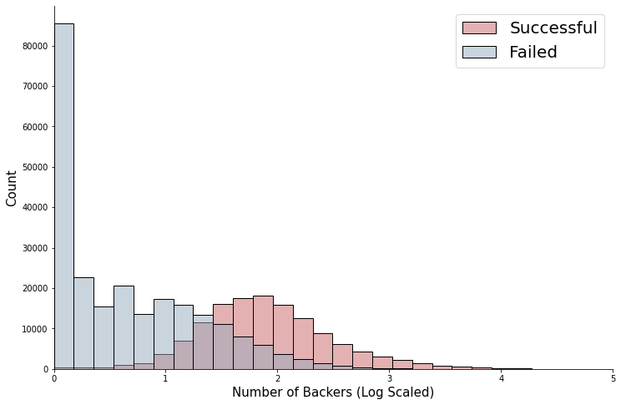
[ Backers ][ Goals ]
Do Backers Matters?
Yes !
Higher number of backers will lead to a
greater chance of Kickstarter success.
Do Goals Matters?
Yes !
The higher the goal amount set,
the less likely a project is successfully funded.
Set Realistic Goals !
Notes:
-- Backers show normal distribution with line graph

Slide 7
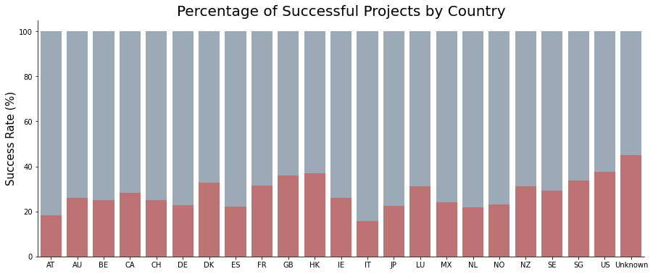
[ Projects per Country ]
Does Launch Country Matter?
No Strong Correlation!
No one country stands out as being exceptional at having successful Kickstarter,
Generally English speaking countries have more projects.

Slide 8
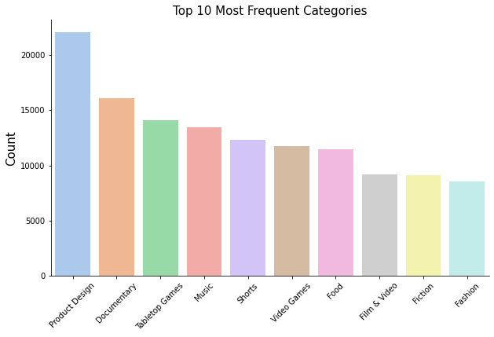
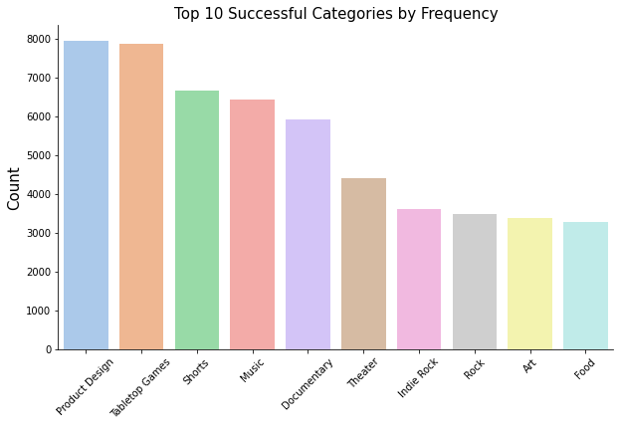
[ Categories ]
Do Categories Matter?
Yes !
Kickstarter Projects reflects city culture
E.g. Film is more popular in LA or Tech is more popular in SF

Slide 9
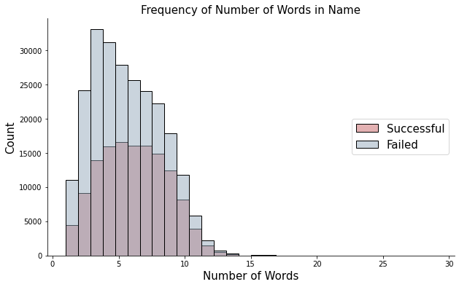
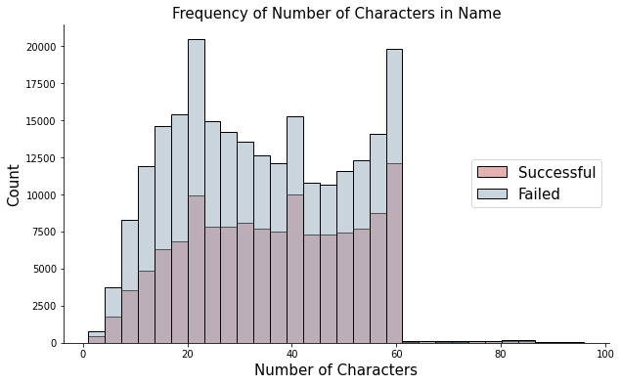
[ Word_Length ][ Char_Length ]
Does Number of Words Matter?
Weak Correlation
Does Number of Characters Matter?
Not for success, but...
Kickstarter cap at 60 characters total.
Short & Concise !
Notes:
--- show example of kickstarter name length ( short vs long)

Slide 10
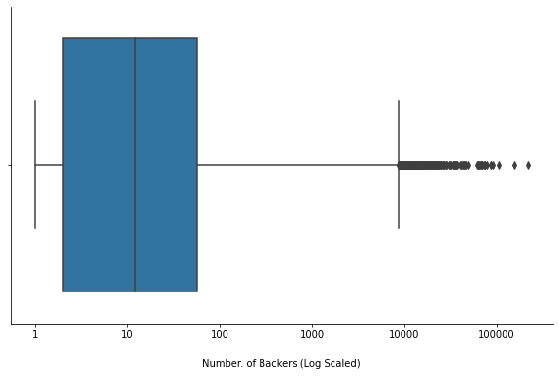

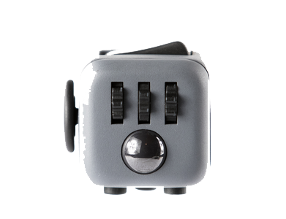

[ Distribution of Backers ]
Exploding Kittens
219,382 Backers
USD 219,382
Fidget Cube
154,926 Backers
USD 6,465,690
Reading Rainbow
105,857 Backers
USD 5,408,916
Notes:
-- Add product pictures

Slide 11
02/03
Machine Learning
Model Evaluation
Model Selection
Notes:
-- Accuracy

Slide 12
[ Methodology ]
Create Model
Engineer Features
Final Model
Evaluate Model
# Decision Tree Classifier
# Random Forest Classifier
# Logistic Regression
#AdaBoost Classifier
# XGBoost Classifier
# Encoding
# Scaling
# Add/Drop Features
# Ability to predict probability of Kickstarter success
Aim for Higher Accuracy
# F1-Score [ Precision / Recall ]
# Hyperparameter Tuning

Slide 13
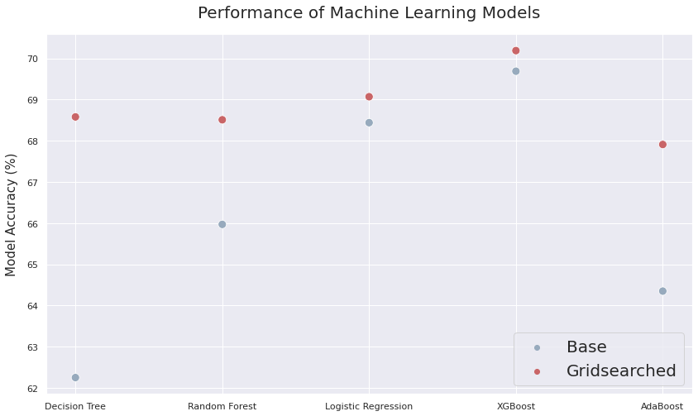
[ Model Comparison ]
Supervised Learning Model
Input Data
[ User Defined ]
Name
Category
Currency
Project Length
Goal (in USD)
Output
[ Prediction ]
State
Success / Failure
Notes:
-- Input ---> Model ---> Output
-- Each Model Challenges & Improvements
-- Methodology - Grid Search for hyperparameter tuning & end accuracy

Slide 14
[ Model Selection ] [ Improvements ]
XGBoost Classifier
Greatest Accuracy Score
(70% vs. 68%-69% for others)
Best balance between ‘Precision’ & ‘Recall’.
(F1-Score 0.50 vs. 0.15-0.45)
Precision roughly equal between models but recall greatly varied.
Action Taken:
Scaling to a different range to give greater weight for certain features
Taking Log Scale of ‘Goal Amount’ provided marginally better results
Attempts at reengineering features resulted in < 1% change for models
Notes:
Which model we chose in the end and why?

Slide 15
[ Future Improvements ]
Additional Data
Project Description
Stretch Goals
Returning Kickstarter
Alternative Models
Neural Network
Exploration
Notes:
Which model we chose in the end and why?

Slide 16
03/03
Business
Value
Product
Prediction

Slide 17

Kickstarting Kickstarter Success
Featured by
Kickstarter
FB / Instagram /
Twitter
>20 Backers
Classified projects as probable success or failure
based on Kickstarter Features, Social Media, and Backers
Importance of social feature !
Featured project has
89% success rate
>1,000 FB friends has 40% success rate
>20 Backers has
50% success rate

Slide 18
“ Our model predicts probability of Kickstarter Success.“

